Slide 1

Vivekanand Education Society’s Institute Of Technology
Master of Computer Applications
Project Review I
Title: LangMate
Domain: Web Application
Group Members:
Member1 : Mohit Tendolkar 56
Member2: Anish Rane 41
Member3: Omkar Hande 17
Mentor Name: Vaishali Gatty

Slide 2
Content
Introduction to the project
Problem Statement
Objectives of the project
Requirements of the system (Hardware, software)
System Design
Front End
Gantt Chart
Conclusion
References

Slide 3
Introduction to Project
LangMate application is a platform that combines a translator and dictionary with language learning resources.
Our platform makes it easy for you to translate and understand foriegn languages, while also providing a comprehensive learning experience.
As this platform provides a combination of translation and dictionary tools, It makes it easy for those who want to understand and
communicate in foreign languages.
r Rates

Slide 4
Problem Statement
Language barriers can often hinder effective communication and limit opportunities for personal and professional growth. In today's globalized world, there is an increasing demand for individuals to be proficient in multiple languages. However, many traditional language learning methods can be time-consuming, costly, and inaccessible to some. Our project aims to address this problem by providing a convenient and comprehensive platform that combines translation and dictionary tools with language learning resources. Our goal is to make language learning more accessible, efficient, and enjoyable for all.
r Rates

Slide 5
Objectives of the project
t easy for. To
To make it easy for users to translate and understand foreign languages.
To provide resources that help users learn a new language efficiently and effectively.
To offer an affordable and convenient language learning platform that can be accessed from anywhere.
To continuously improve and update the platform to better meet the needs of language learners.

Slide 6
Requirements of the system (Hardware, software)
Hardware Requirements:-
A computer or mobile device with a modern web browser (such as Chrome, Firefox, or Safari) and an internet connection.
Should have a good quality speaker to enjoy the benefit of text-to-speech.
Ram should be around 2gb for smooth experience.
Software Requirements:-
Operating System: Windows 7 Onwards.
A programming languages such as HTML, CSS, JavaScript, to develop the application.
Problem Statement

Slide 7
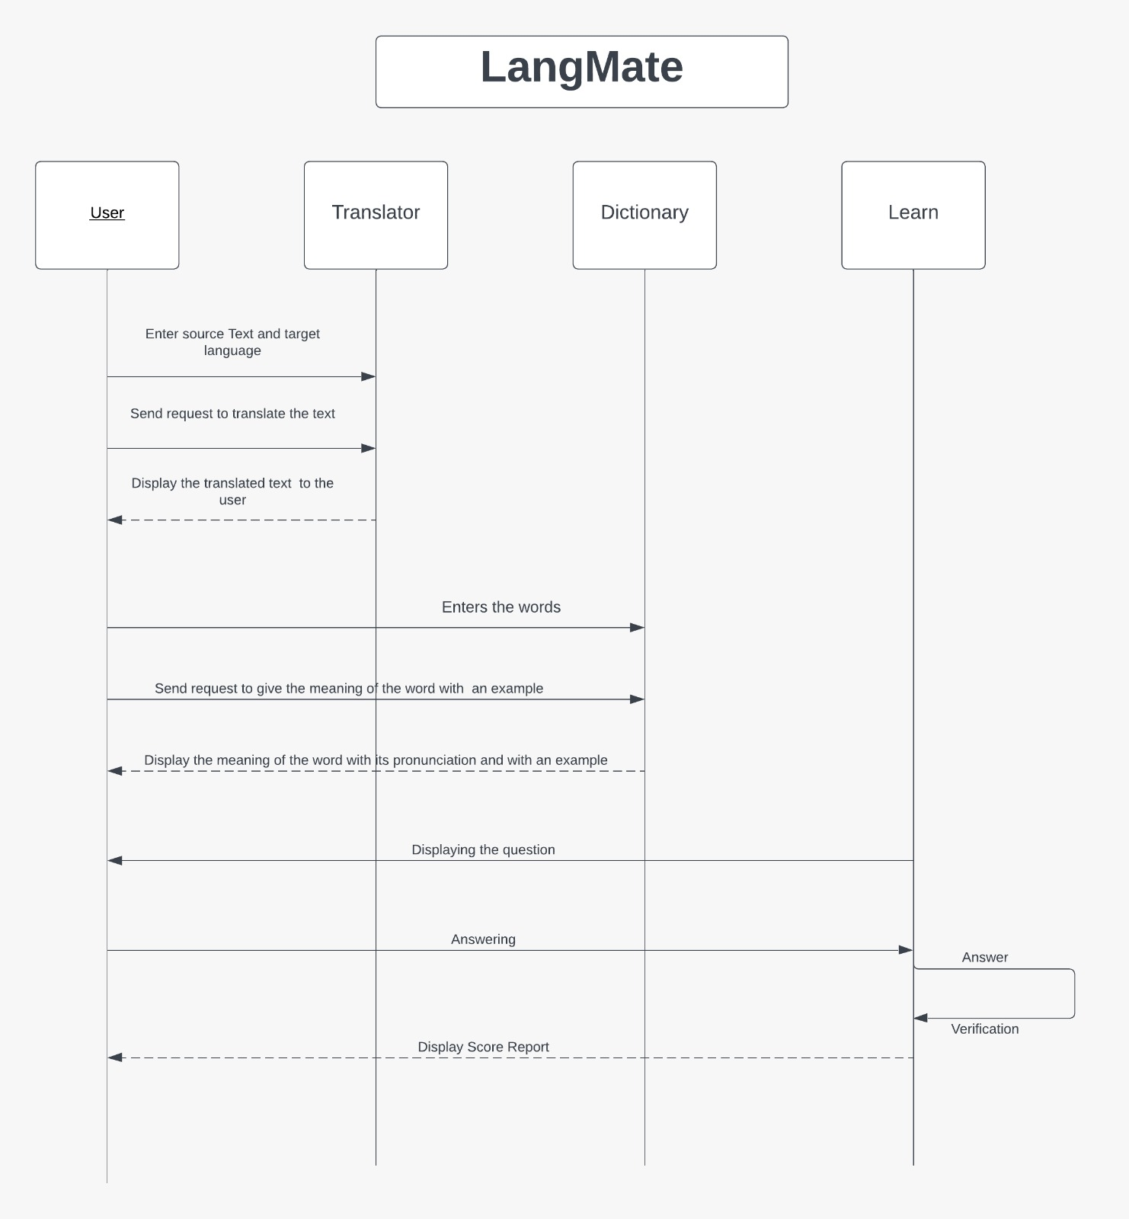
System Design of the proposed system
SEQUENCE DIAGRAM:

Slide 8
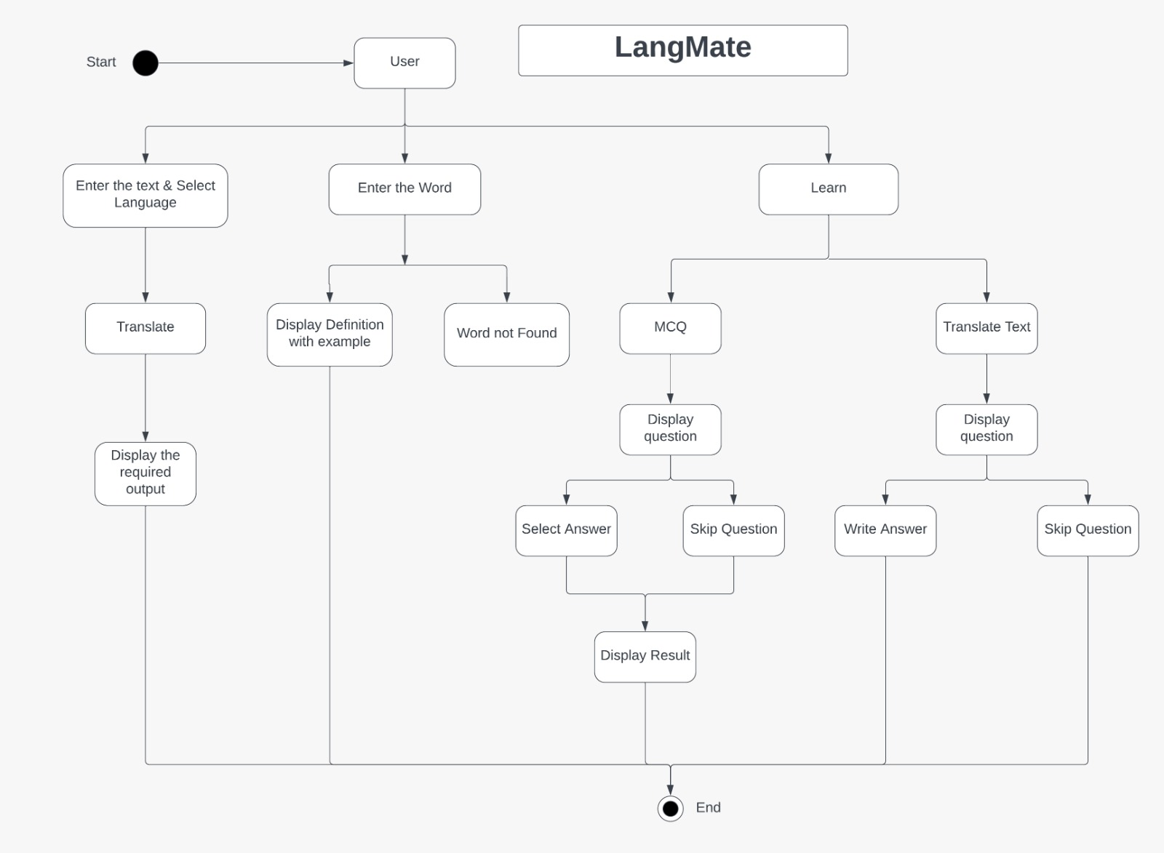
System Design of the proposed system
ACTIVITY DIAGRAM:

Slide 9
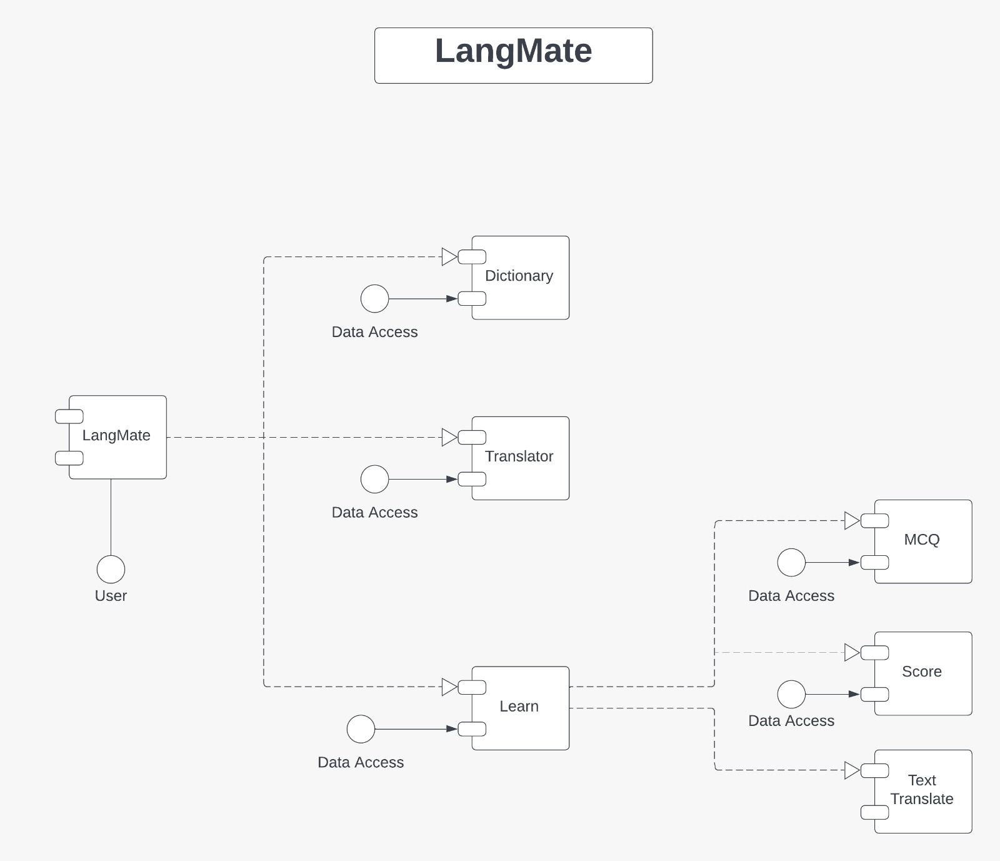
System Design of the proposed system
COMPONENT DIAGRAM:

Slide 10
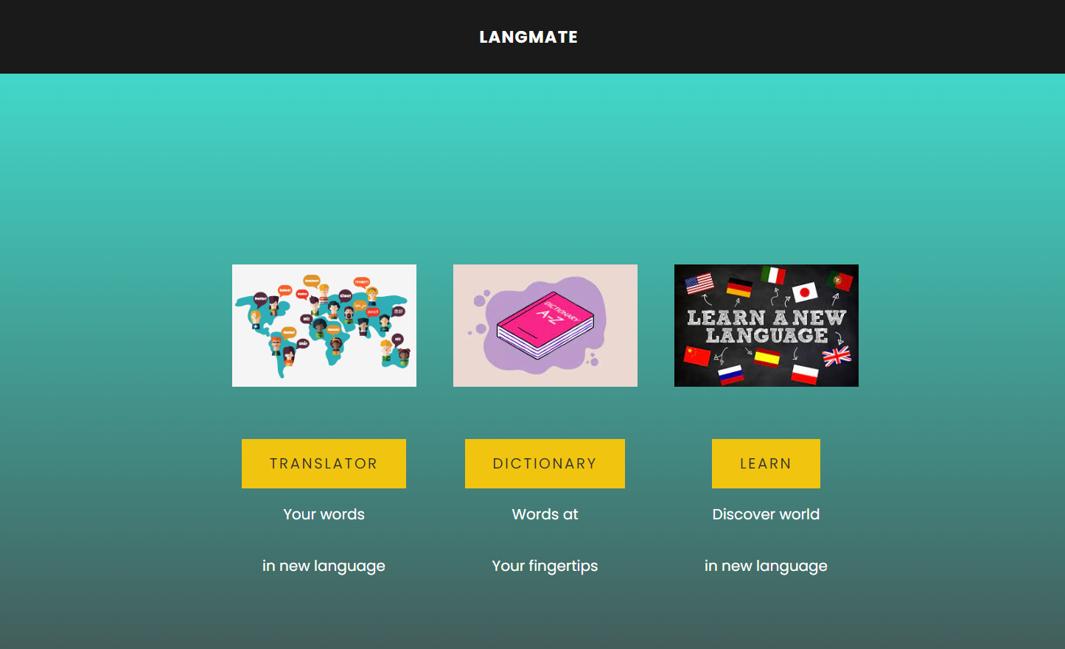
Front End
FIRST PAGE →

Slide 11
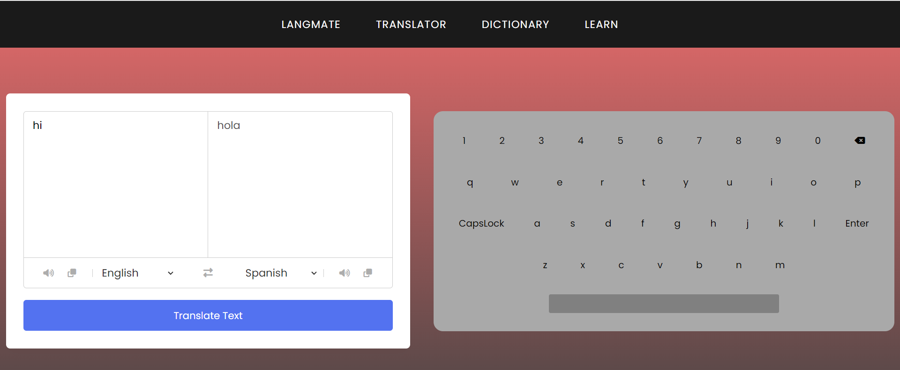
Front End
TRANSLATOR ->

Slide 12
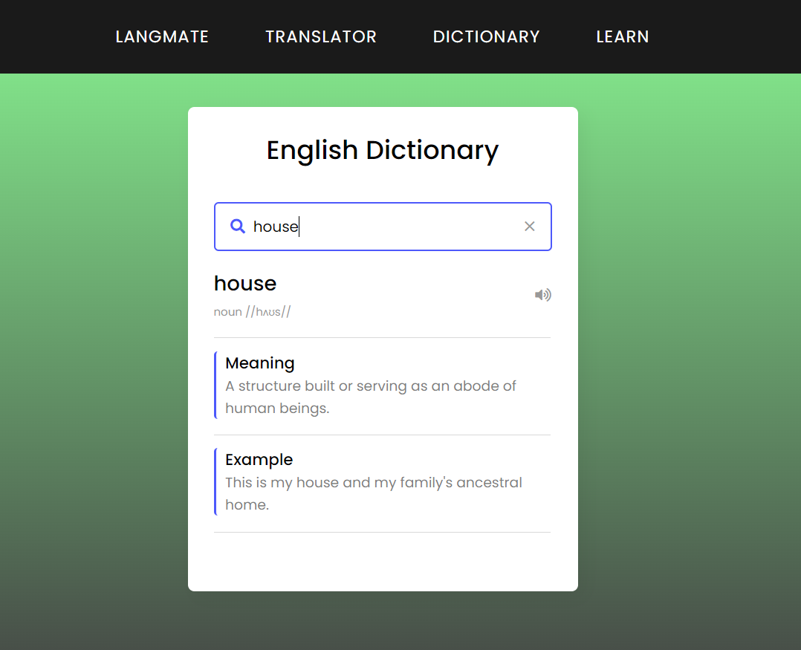
Front End
DICTIONARY ->

Slide 13
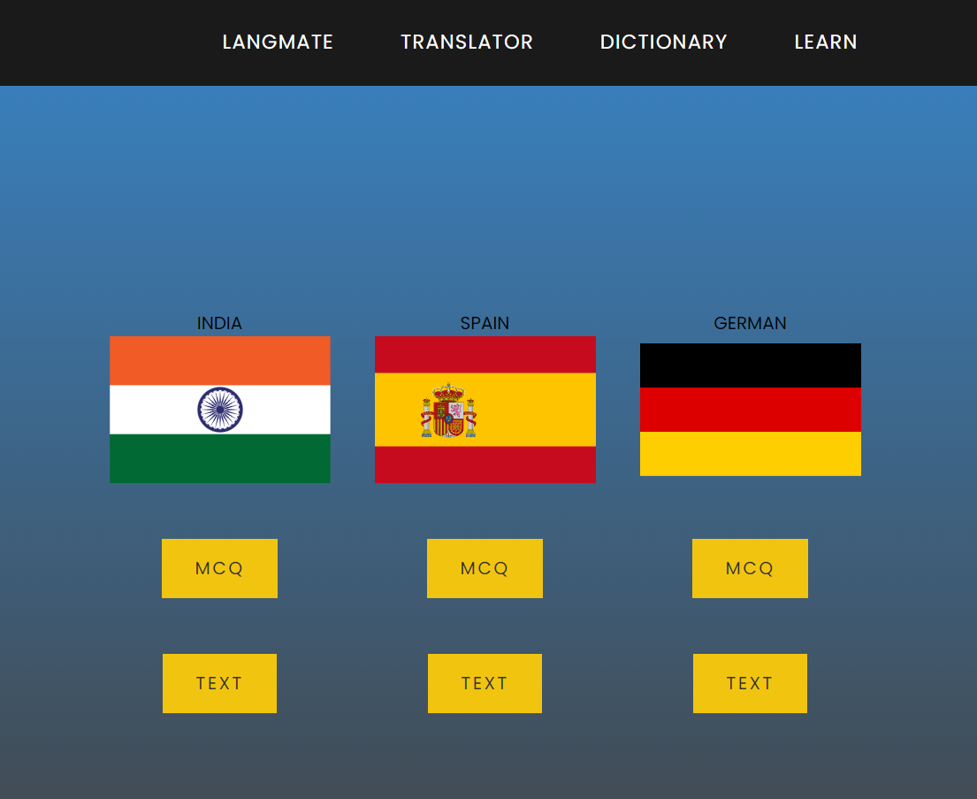
Front End
LEARN ->

Slide 14
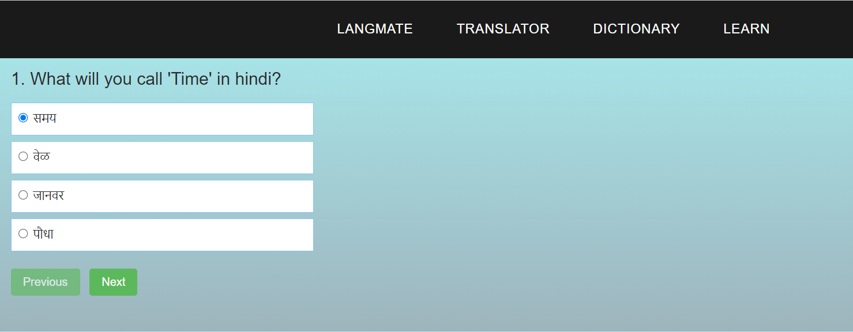
Front End
QUIZ INTERFACE ->

Slide 15
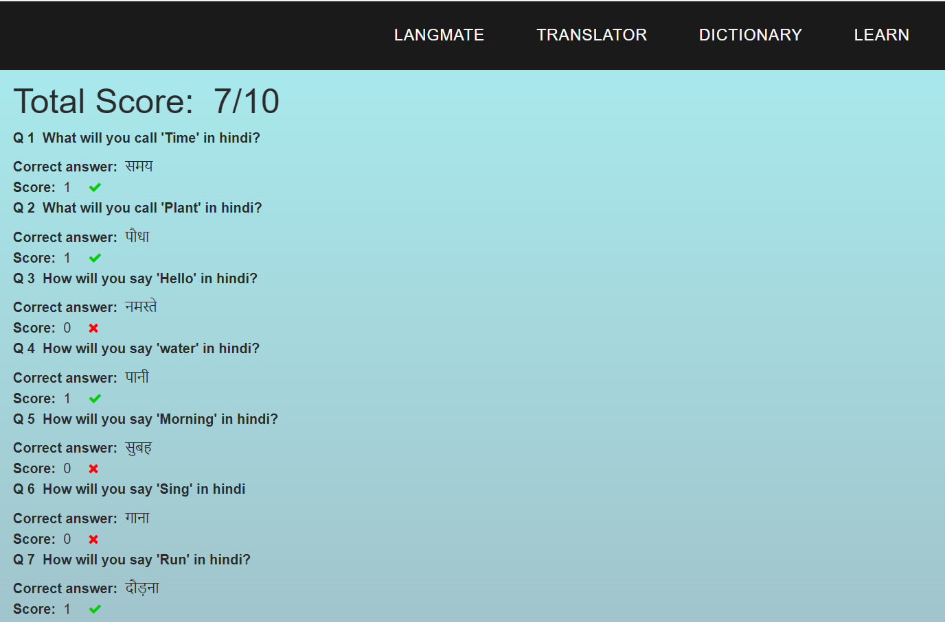
Front End
SCORE OF QUIZ ->

Slide 16
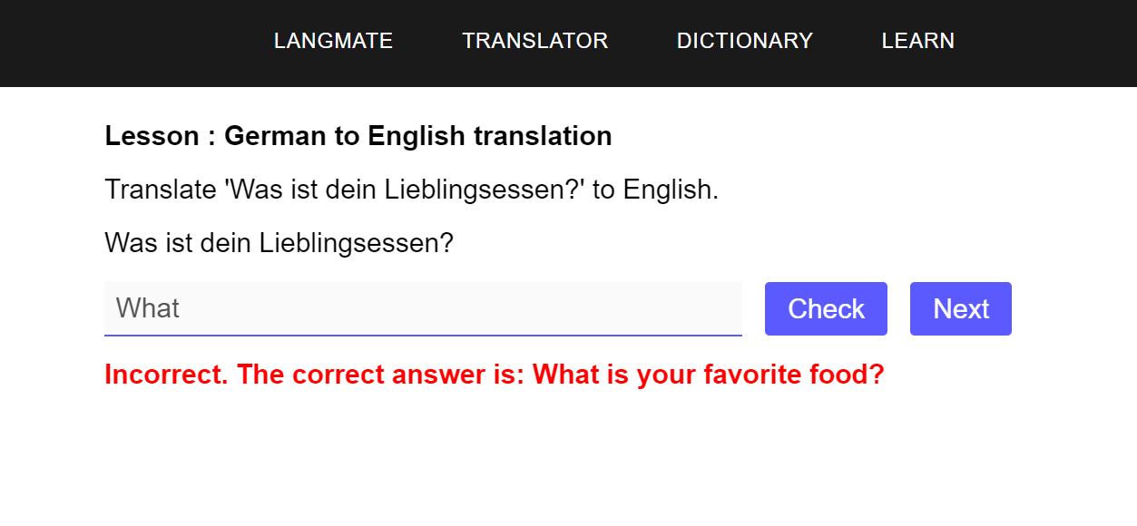
Front End
Translate the text ->

Slide 17
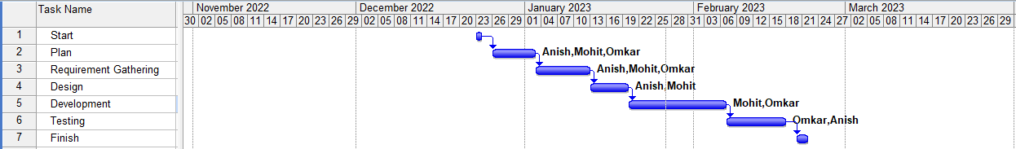
Gantt Chart
Notes:
The max flow algorithm in the visualization is :-

Slide 18
Conclusion
Increased language proficiency: The platform should help users improve their language skills and gain fluency in their desired language(s).
Increased accessibility: The platform should make language learning more accessible to a wider audience as it is convenient and can be accessed from anywhere.
Increased engagement: The platform should provide engaging and interactive learning resources that keep users motivated and interested in learning a new language.

Slide 19
References
https://blog.duolingo.com/
https://www.w3schools.com/html/
https://www.w3schools.com/css/default.asp
https://www.w3schools.com/js/default.asp
https://getbootstrap.com/docs/5.3/getting-started/introduction/
https://en.wikipedia.org/wiki/Google_Translate

Slide 20
THANK YOU !!!!!

